Slide 1

O-2 Keeper

Slide 2

Team Name: God Pheonix
Team member:
AALAP BHAKTA
RITHIV R
Domain/theme: Health
Project Statement: To demonstrate a project based on Mobile app which would help in oxygen crisis.

Slide 3

Abstract
This is the project called O2 Keeper which is based on the life keeping gas none other than Oxygen . Due to Covid-19 we were in our homes for past 1 and half year and during the start of 2021 , the Covid – 19 second wave was much stronger than first in India and we lost most our brothers and sisters of the nation and during that stage there was a sudden decline in the amount of the supply of oxygen all around India.
During that situation we got help from most of volunteers. This basically gives you the details of the oxygen vendors who is nearby and it also gives you an opportunity to look over Oxygen vendors details in State wise and district wise in India. Even if the third wave of Covid-19 comes too, I hope that this app would be useful in future if there was unexpected crisis of Oxygen. The complete details for this project details mentioned in the upcoming slides.

Slide 4

Novelty & Cause
In this project we are going to use your latitude and longitude to find your location and based on your location we are going to oxygen vendors who are near by you and in you district.
In this map we are going to integrate with maps for finding location of oxygen vendors to give a better convenience of User.
There will be proper user authentication for everyone.
In this project we are going to implement state wise and district wise oxygen vendors searches.
We also integrated donation web inside our app.
We are also going to be having FAQs on covid awareness.
With the help of this app, we are trying to ease of contact to oxygen suppliers in time of crisis

Slide 5

Technology Stack
FLUTTER
FIREBASE
FIRESTONE
For stimulation of the Code:
Download android studio
Flutter SDK

Slide 6
Plan of Implementation
First day We are collecting the Data for the vendors, designing Wireframes for the Application, and creating the database.
Second Day Planning to complete the Front designing using flutter and finishing the database.
Third day We will integrate all the parts and trial it out.

Slide 7
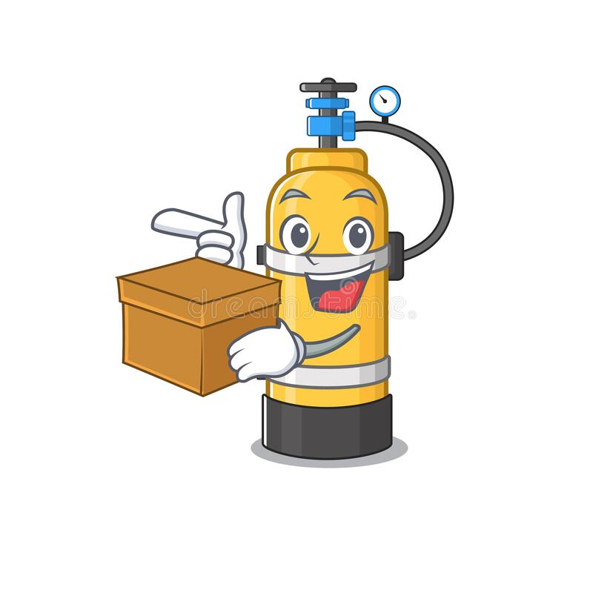
Project Outcomes for users:
With help of this app, we tried improve the connection between oxygen keepers and people for provision of oxygen cylinders.
We tried to give the O2 keeper a place where all their DATA will be safe.
We aimed to solve the problem of finding Oxygen vendors near to user location
The user can also share vendor details to others. Plus, he can also see the O2 keeper for other states and districts
He can also search for the details for vendors.

Slide 8

Process Flow:
We figured out solution for fighting back against the oxygen crisis problem if the oxygen crisis occurred in later life period.
We collected the oxygen vendors details for the states and going deeper we collected the oxygen vendors details districtwise in the state.
We entered the data manually for the oxygen vendors details for the statewise and districtwise details in Firebase Firestore of Google.
After manually entering data which would be working as our backend. We displayed the user location in map and based on the user location we found the nearby oxygen vendors and we also pin pointed the place where the oxygen vendors in the map .
For finding near by places we went through a problem that cost needed for handling APIs of Goggle for finding near by location , so we figured out a way that instead of going with google API , we used flutter packages for getting latitude and longitude of the person or user.
Mobile APPLICATION using FLUTTER and FIREBASE for authentication and FIRESTORE for Database.

Slide 9
Process Flow:
Based in the user latitude and longitude we found the district i.e region of the user using this latitude and longitude called backward geoencoding using Positioned Stack API.
After fetching the region details we figured out an algorithm for finding the oxygen vendors details of the person nearby.
Then if you clicked the details of vendors you would be having the map with the pins of your location and the destination location i.e the vendor location.
Then we have added search operation for user to find the oxygen vendors details he wanted.
Then we have created a statewise view so the user be able to see the details of the other states also going depper we have also implemented districtvwise view based on this oxygen vendors details of the particular district.
We also enabled the option of sharing the oxygen vendors details.
We also enabled the sign up and sign in portal for user authentication.
By this way we found the solution for the problem of finding oxygen vendors during crisis. And we also implemented the

Slide 10
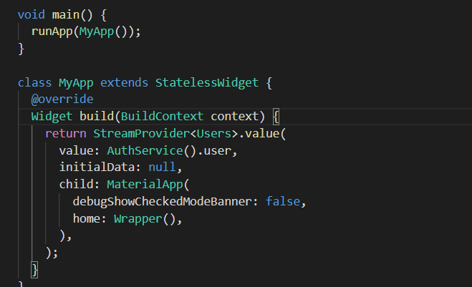
Just a glance on start of code:

Slide 11
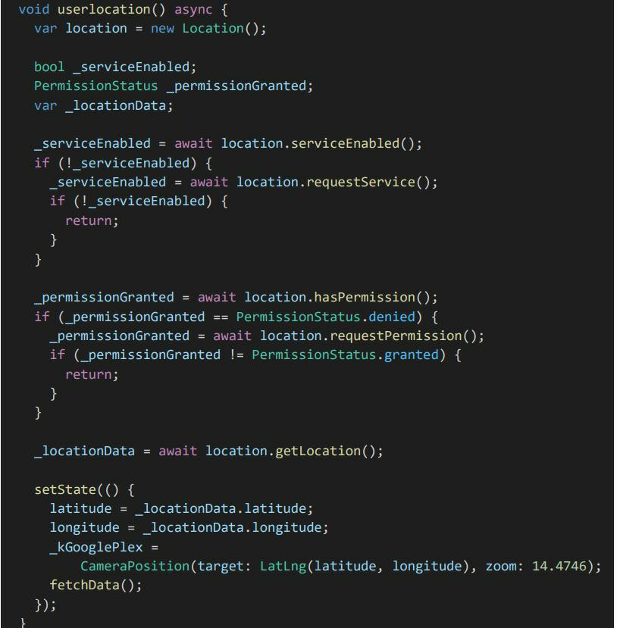
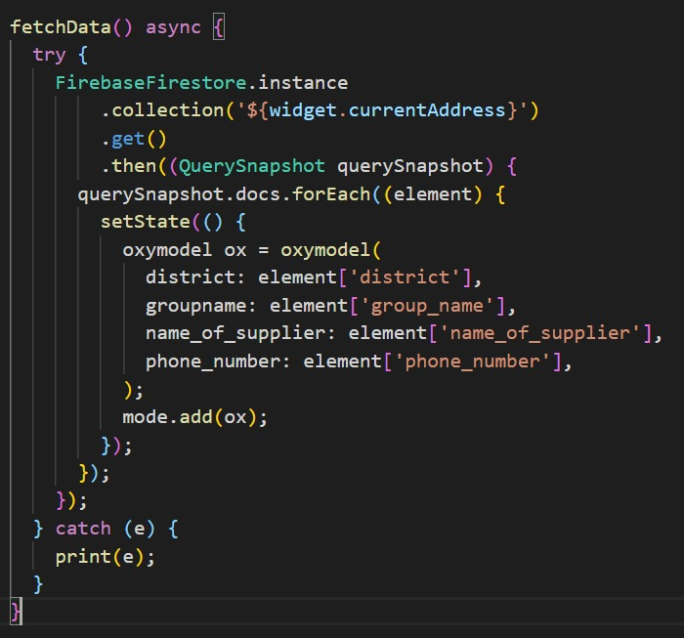
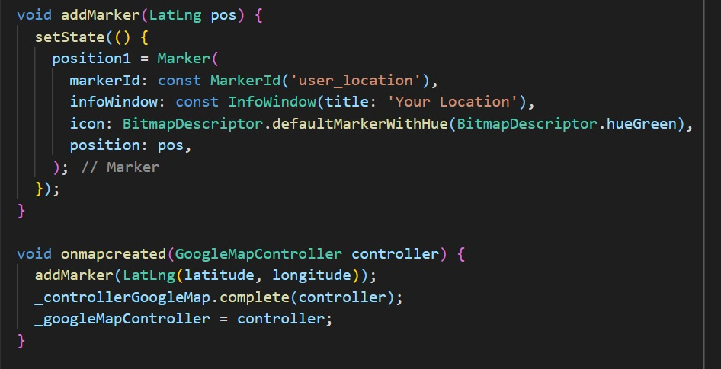
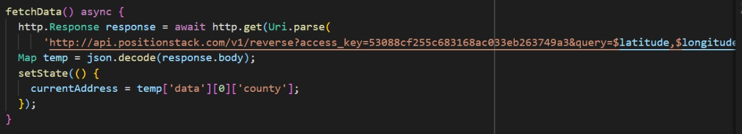

Slide 12
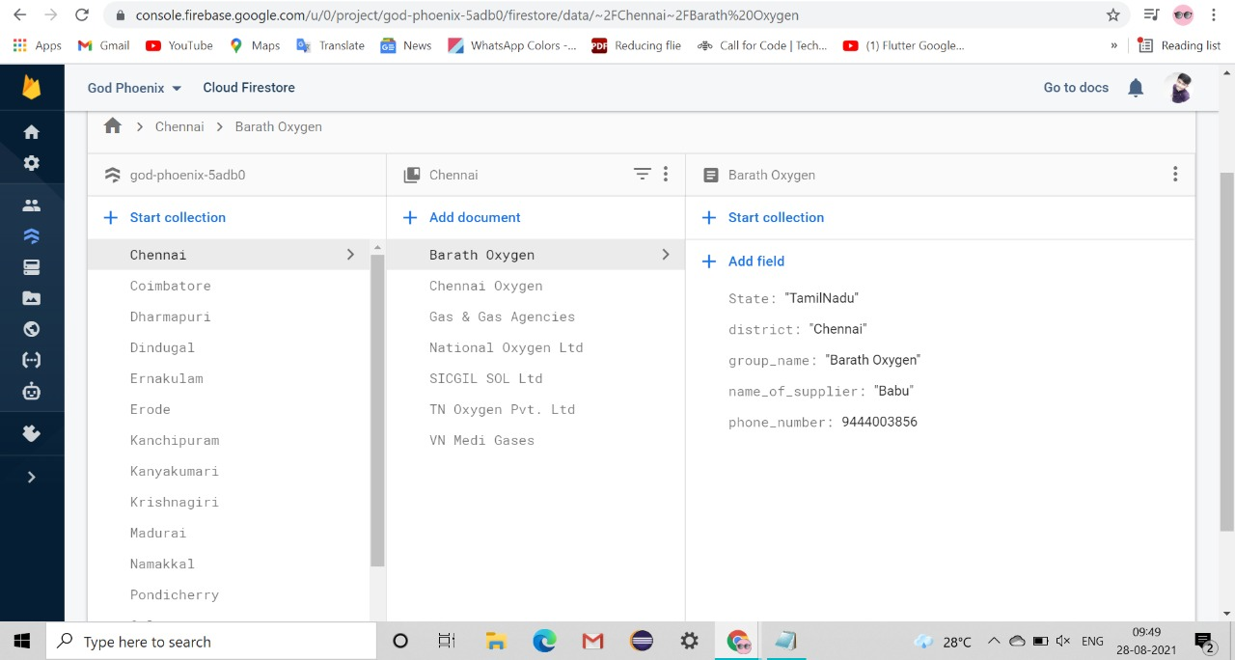
Creation of Database in Firebase

Slide 13
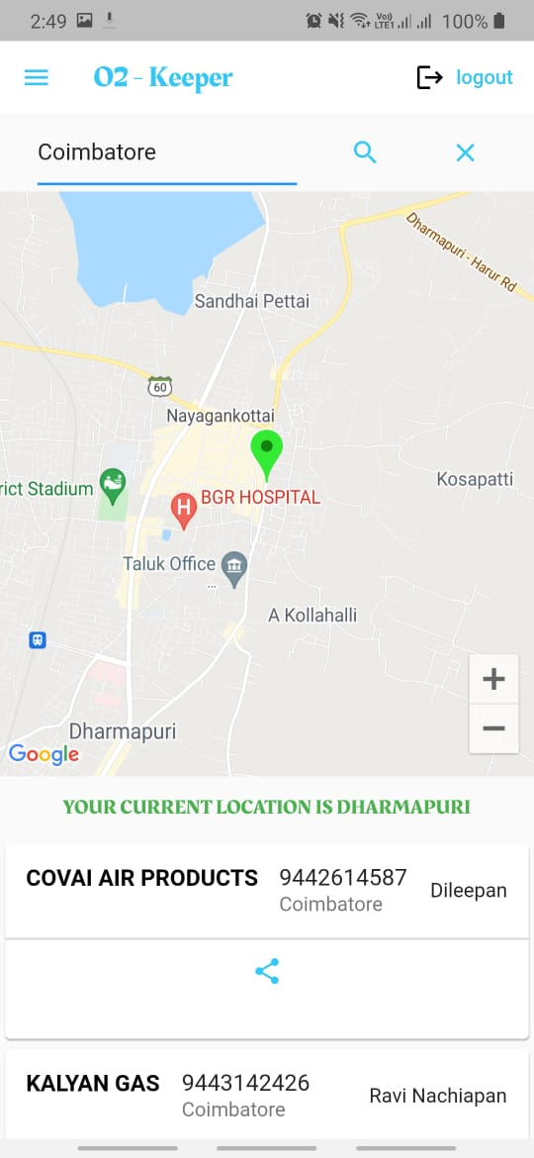
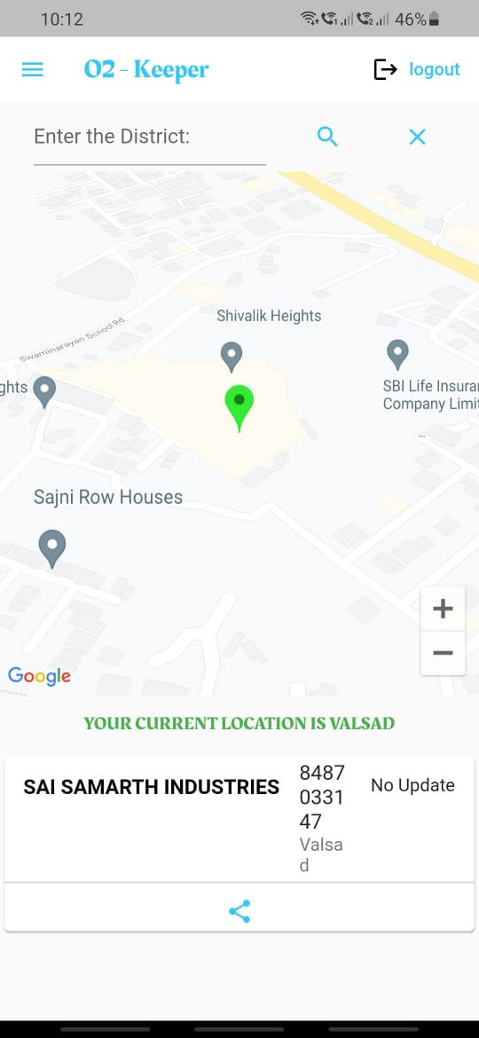
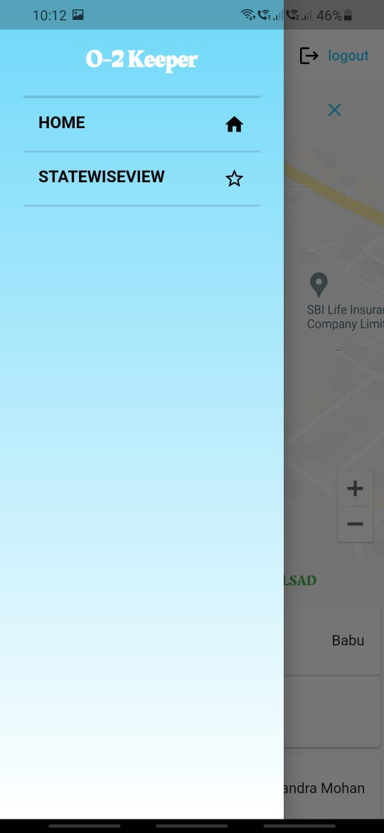
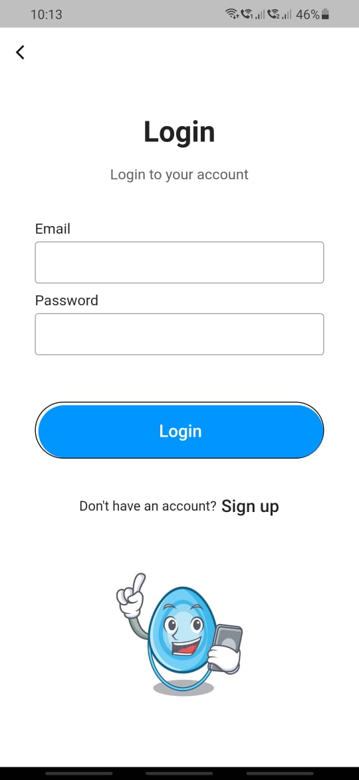
Result glance

Slide 14
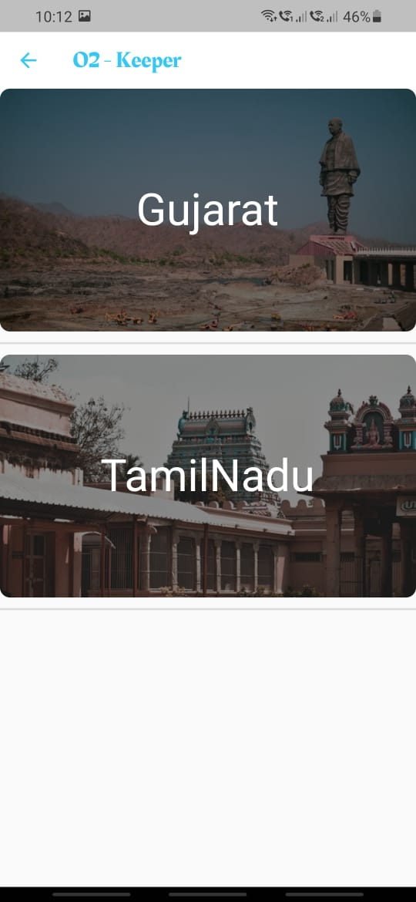
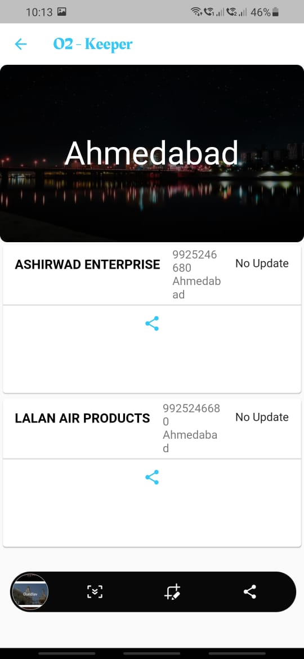
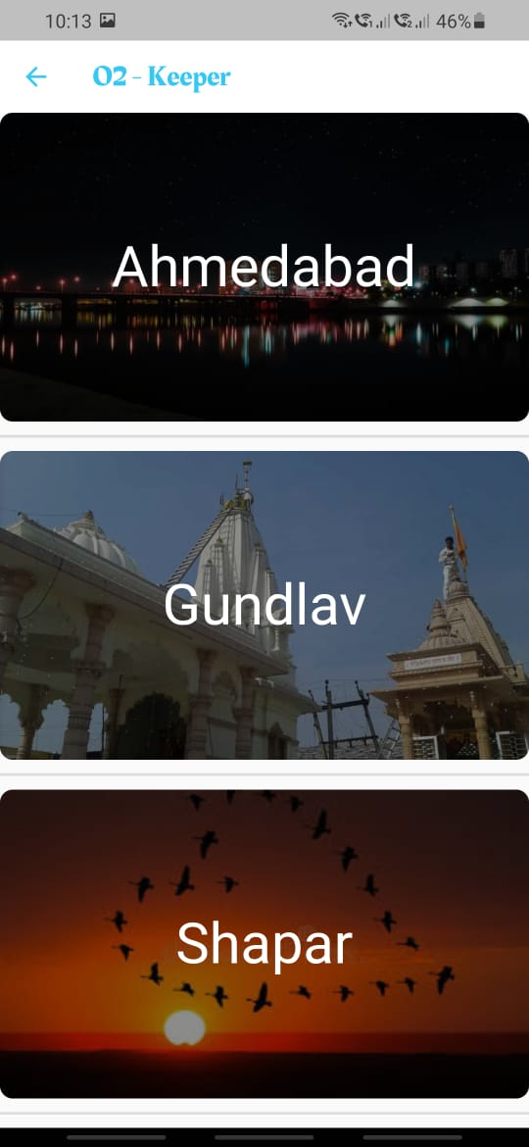
Result glance

